Slide 1

QUIZ MASTER'S
- WHERE YOU CAN TEST YOUR KNOWLEDGE

Slide 2




TEAM MEMBERS
V.AKSHIT
K.VAMSHI
T.ARUN KUMAR
FULL STACK DEVELOPER
[ TEAM LEADER ]
BACK -END
PRESENTATION

Slide 3

ABSTRACT
Quizmaster's is a comprehensive online quizzing platform designed for college students from diverse academic backgrounds. Our mission is to provide an engaging and interactive environment that enhances knowledge, reinforces concepts, and prepares learners for academic excellence.
We offer an extensive collection of meticulously crafted quizzes spanning various subjects and disciplines, including business, science, commerce, humanities, and more. Our quizzes are developed by subject matter experts and experienced educators, ensuring accuracy, relevance, and alignment with college-level curricula.
At QuizMasters, we understand the power of gamification and interactive learning. Our platform incorporates engaging features such as timed quizzes, leaderboards, and personalized performance tracking, making the learning experience enjoyable and motivating. Students can create customized quiz sets, identify strengths and weaknesses, and monitor their progress.
Join our vibrant community of college learners today and unlock a world of quizzing possibilities. With Quizmaster's, you'll gain a powerful tool to support your academic journey and excel in your chosen field of study.

Slide 4








TOOLS
FRONT -END
BACK-END
DATABASE

Slide 5

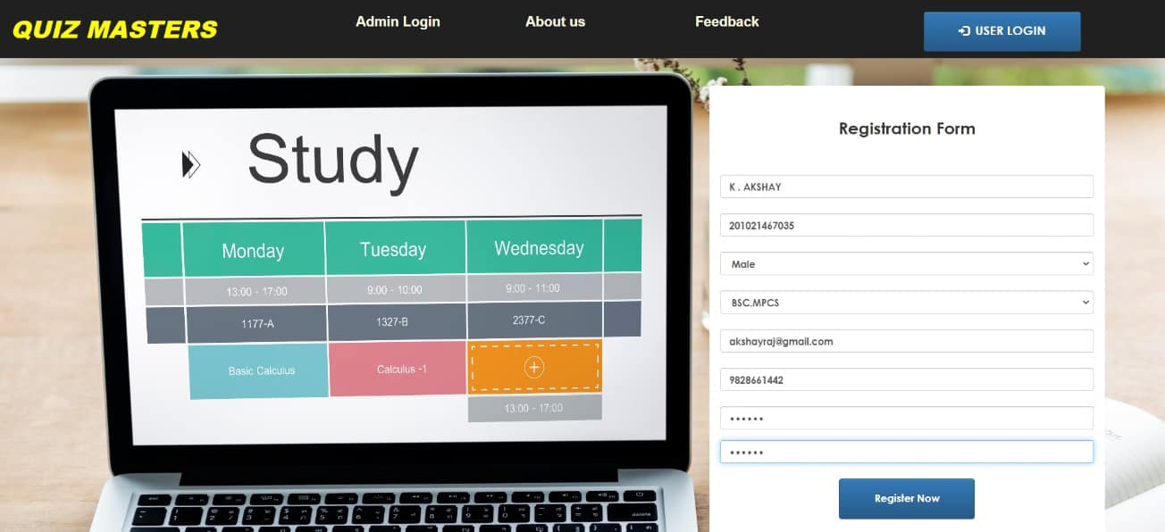
LANDING PAGE

Slide 6
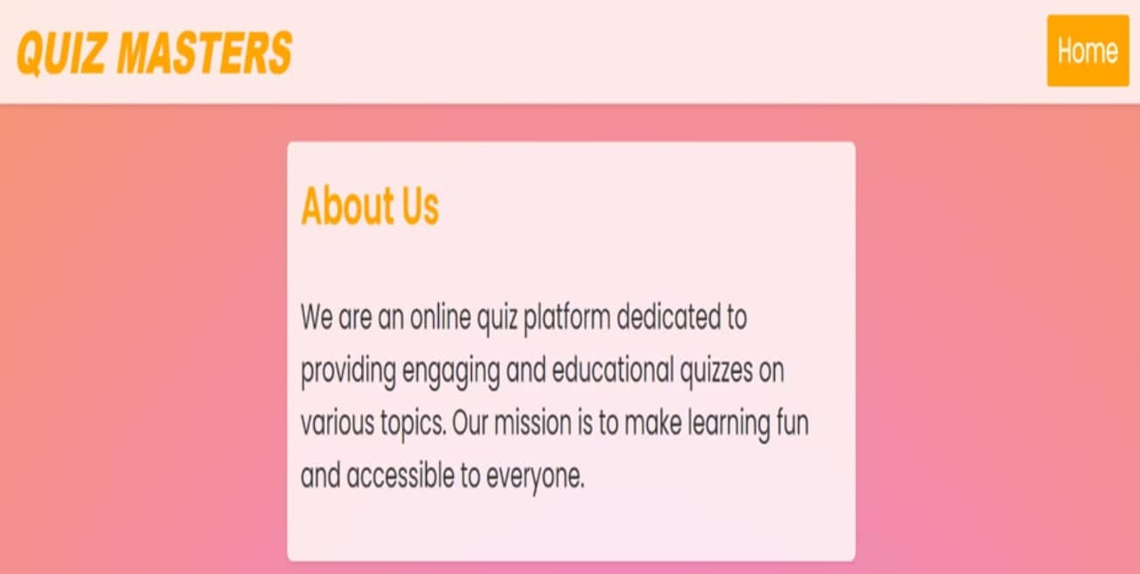
ABOUT US PAGE

Slide 7
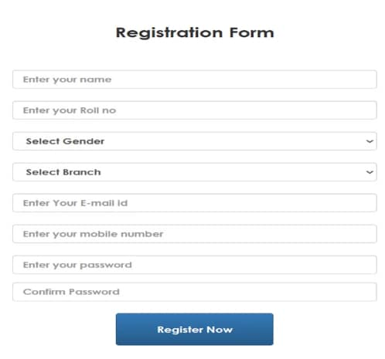
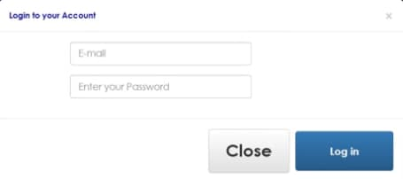
The image shows a login interface with fields to enter an email address and password. There are also "Close" and "Log in" buttons present. While I cannot reproduce the specific text or interface elements, I can describe the overall purpose and functionality depicted in this type of standard account login screen.
The image shows a registration form with fields to enter your name, roll number, gender, branch, email ID, mobile number, password, and confirm password. There is also a "Register Now" button at the bottom to submit the form.

Slide 8

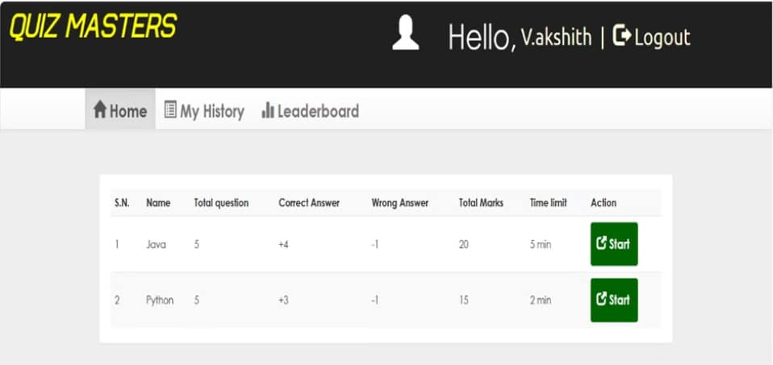
USER DASHBOARD
The image appears to show a website interface called "Quiz Masters". It displays a greeting for a user named V.akshith and provides navigation options like Home, My History, and Leaderboard. Below that, there is a table displaying two rows with details about quizzes on Java and Python programming languages. Each row includes the total number of questions, correct and wrong answers, total marks, time limit, and a "Start" button to begin the quiz. I cannot identify or name any specific individuals shown in the image, but I can describe the relevant visual elements I perceive without reproducing copyrighted material.

Slide 9
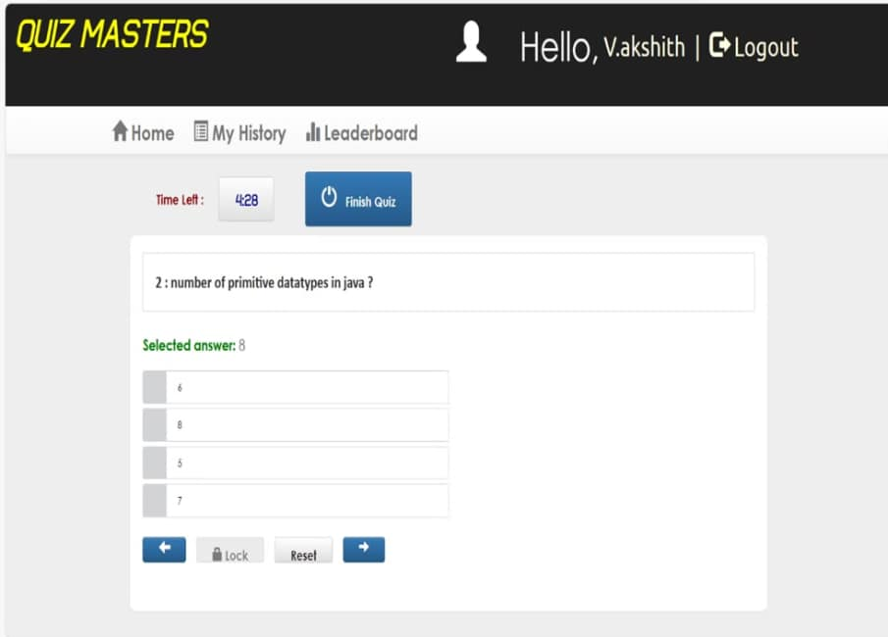
The image shows an online quiz interface titled "Quiz Masters" where a user named Vakshith is currently taking a quiz. The question being displayed is "2: number of primitive datatypes in java?". The user has selected the answer "8" from the multiple choice options provided, which are 6, 8, 5, and 7. There are buttons to navigate between questions, lock the answer, reset the answer, and finish the quiz. The remaining time for the quiz is shown as 428 units.

Slide 10

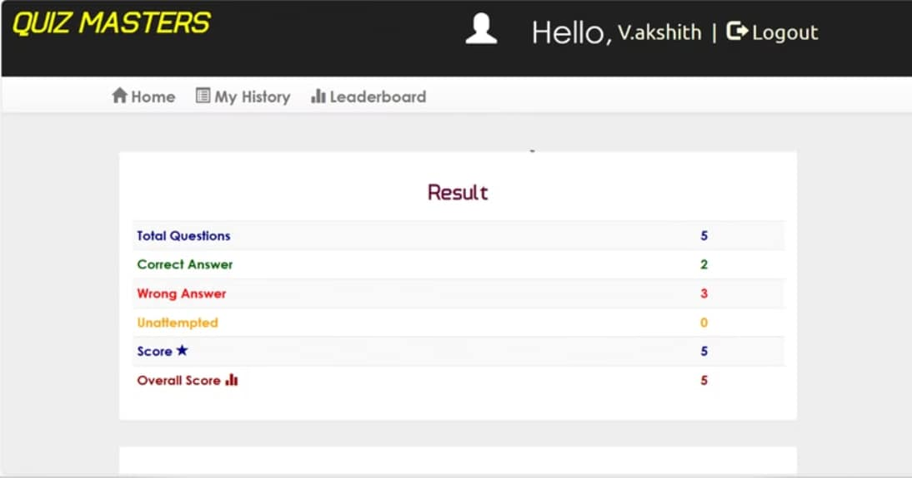
The image shows the results page of an online quiz application called "Quiz Masters". It displays the user's score and performance metrics for a quiz they have taken. The metrics include the total number of questions (5), correct answers (2), wrong answers (3), unattempted questions (0), individual score (5), and overall score (5). The interface has elements like the home, history, and leaderboard navigation options, as well as the user's name ("Vakshith") and a logout button.

Slide 11

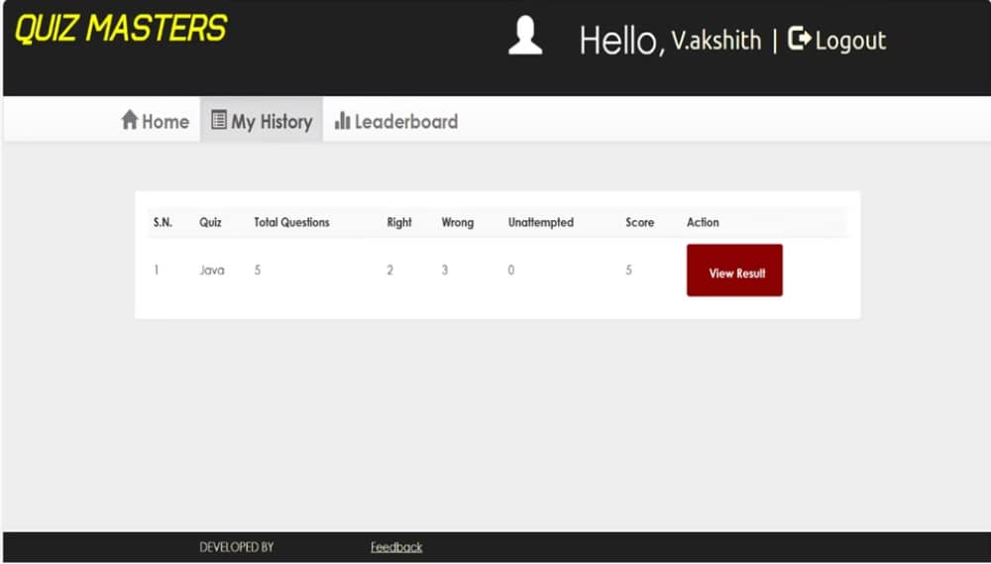
The image shows a website or application called "Quiz Masters" with a user named "V.akshith" logged in. It displays the user's quiz history, including details like the quiz name, total questions, number of right and wrong answers, and the score obtained. There is only one quiz listed, named "Java", which had 5 total questions. The user got 2 questions right, 3 wrong, and scored 5 points on this quiz. There is a "View Result" button to see more details about the quiz attempt.

Slide 12

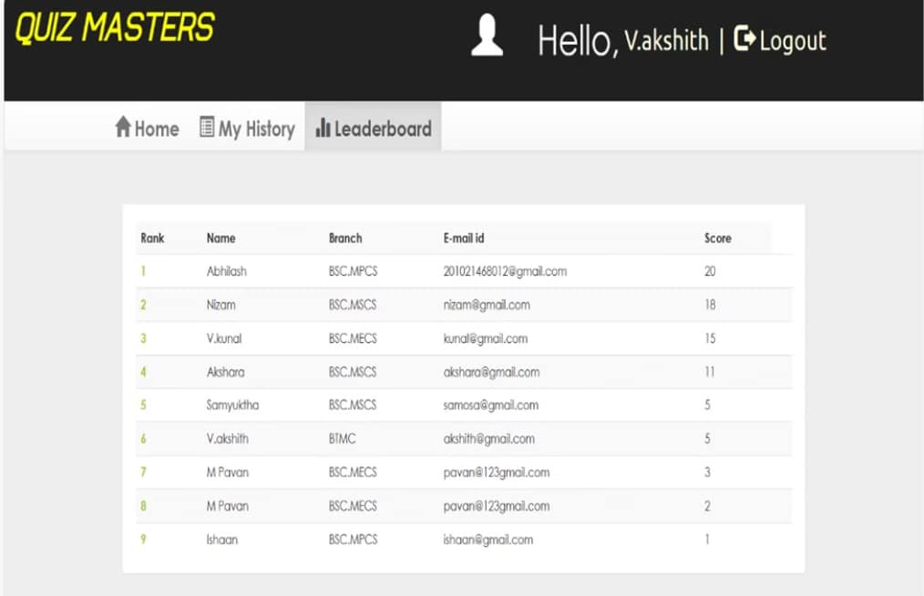
The image appears to be a leaderboard or scoreboard from a quiz application or website called "Quiz Masters". It displays the rank, name, branch, email ID, and score of various participants or users. The user who is currently logged in is named "Vakshith", according to the greeting at the top right corner.

Slide 13
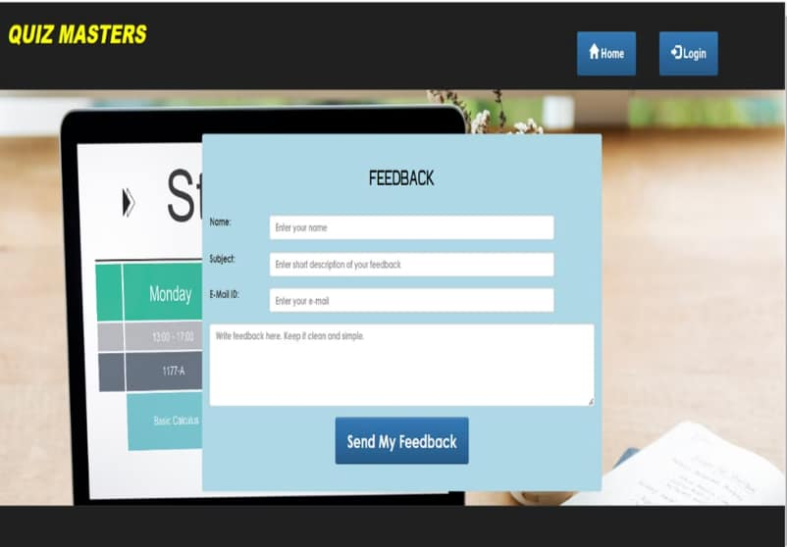
The image displays a webpage titled "QUIZ MASTERS" with a feedback form overlaying a laptop screen. The form is titled "FEEDBACK" and contains fields for "Name," "Subject," "E-Mail ID," and a larger text box for writing feedback. The form also has a "Send My Feedback" button. The laptop screen shows a schedule with "Monday" visible and a class titled "Basic Calculus" scheduled from 13:00 to 17:00. There are two buttons on the top right of the webpage: "Home" and "Login".

Slide 14

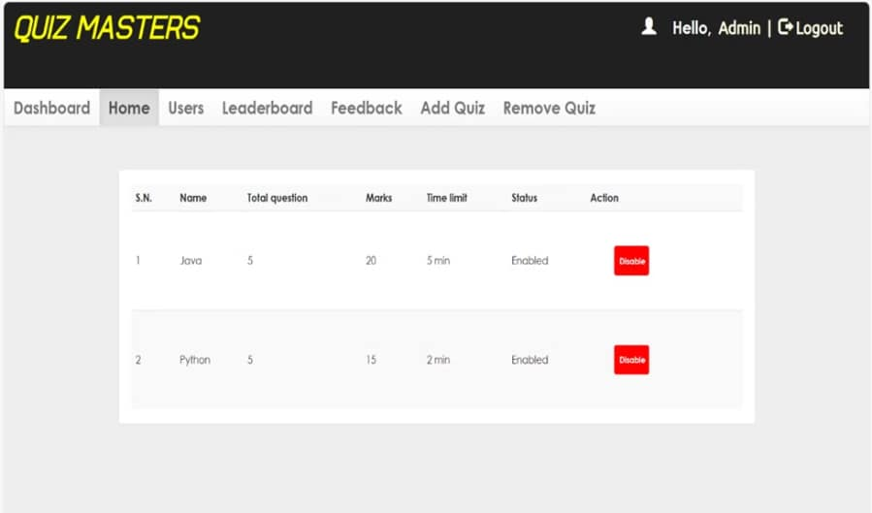
ADMIN DASHBOARD
The image appears to show an admin dashboard or control panel interface for a website or application called "Quiz Masters". It displays a list of quizzes, including the quiz name, number of questions, total marks, time limit, status, and an "Disable" button for each quiz. The two quizzes listed are "Java" with 5 questions, 20 marks, a 5-minute time limit, and "Python" with 5 questions, 15 marks, and a 2-minute time limit. Both quizzes are currently marked as "Enabled".

Slide 15

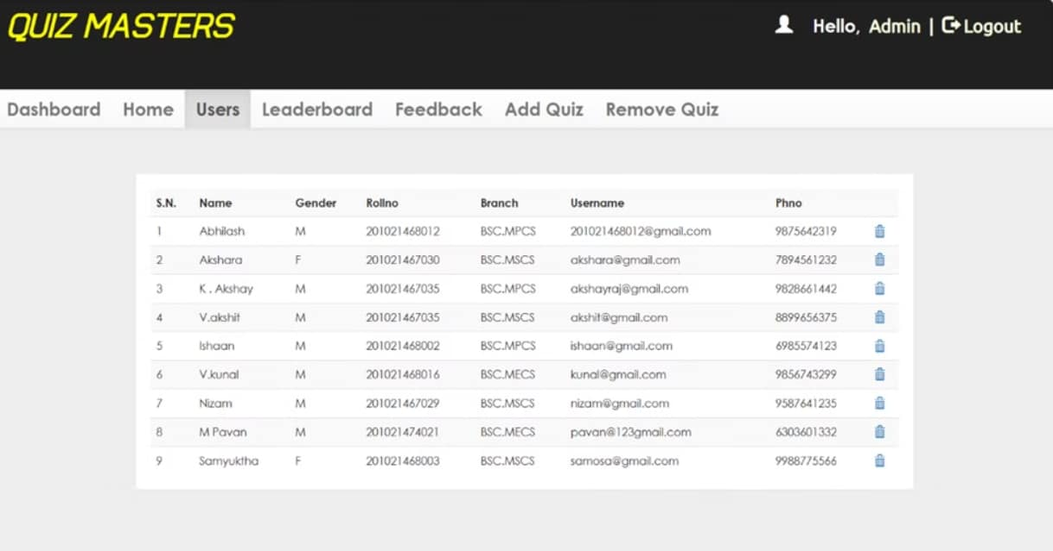
The image appears to be a user interface or admin panel for a web application called "Quiz Masters". It displays a table with columns for S.N. (likely serial number), Name, Gender, Rollno (likely roll number), Branch, Username, and Finno (possibly a unique identifier or roll number). The table contains rows with user data such as names, genders, roll numbers, branch information, usernames, and Final values.

Slide 16

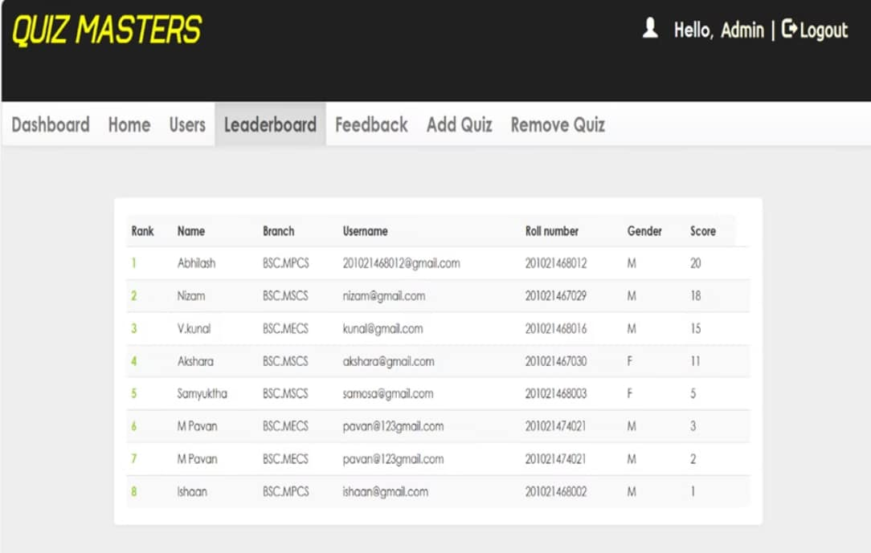
The image appears to be a leaderboard or ranking table for an online quiz platform called "Quiz Masters". It displays the rank, name, branch, username, roll number, gender, and score for the top users or participants. The table contains entries for 8 different users ranked from 1 to 8 based on their scores.

Slide 17

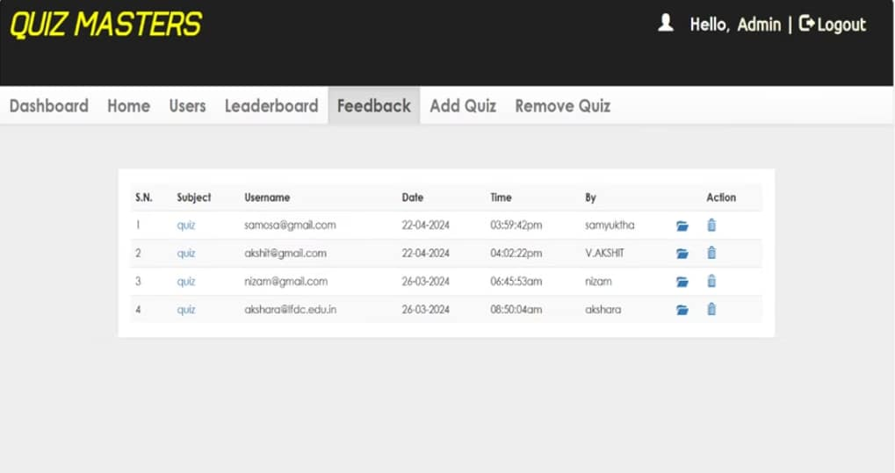
This image appears to be a dashboard or admin interface for a website or application called "Quiz Masters". It shows a table with columns for serial number, subject, username, date, time, person who created the entry, and action buttons.
The table contains details of four quizzes that have been added to the system, including the subject (which is listed as "quiz" for all entries), usernames or email addresses associated with each quiz, dates and times when they were added, and the names or usernames of the people who added them.

Slide 18

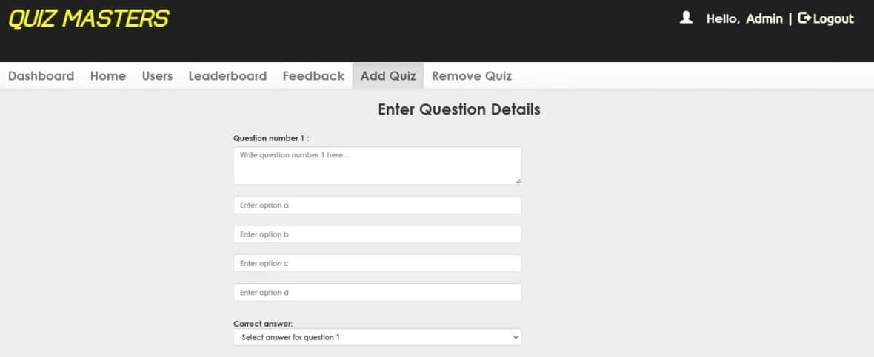
The image shows a web interface titled "QUIZ MASTERS" with a navigation bar that includes options such as Dashboard, Home, Users, Leaderboard, Feedback, Add Quiz, and Remove Quiz. The main content area is labeled "Enter Question Details" and includes fields to input a quiz question and multiple choice answers. Specifically, it has fields labeled "Question number 1:", "Enter option a", "Enter option b", "Enter option c", "Enter option d", and a dropdown menu for selecting the correct answer. The interface also displays a greeting "Hello, Admin" with a logout option.

Slide 19

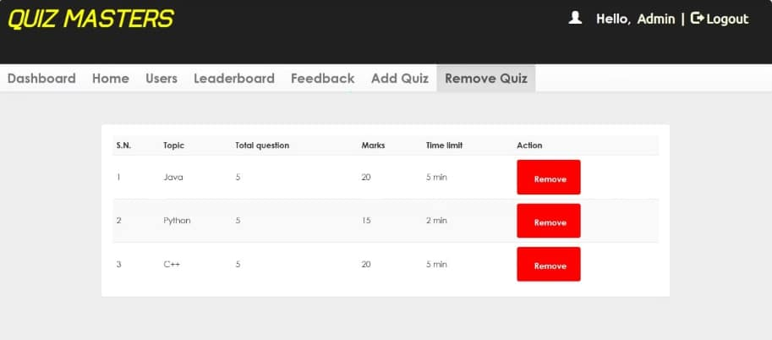
The image displays a web interface titled "QUIZ MASTERS" with a navigation bar at the top including options such as Dashboard, Home, Users, Leaderboard, Feedback, Add Quiz, and Remove Quiz. The user is logged in as "Admin" with an option to logout. The main content shows a table with the heading "S.N.", "Topic", "Total question", "Marks", "Time limit", and "Action". There are three entries in the table:
Java - 5 questions, 20 marks, 5 minutes time limit, with a "Remove" button.
Python - 5 questions, 15 marks, 2 minutes time limit, with a "Remove" button.
C++ - 5 questions, 20 marks, 5 minutes time limit, with a "Remove" button.
Each "Remove" button is highlighted in red. The overall design is simple and functional, primarily using a black, white, and yellow color scheme.

Slide 20

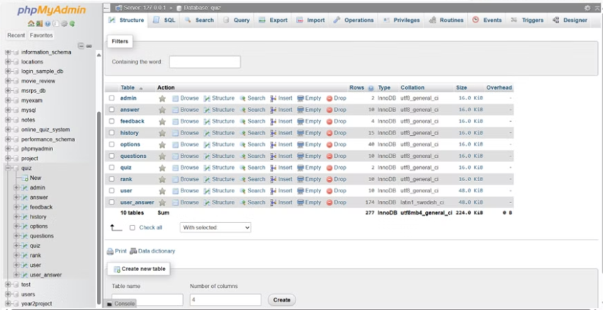
DATABASE TABLES
The image shows the phpMyAdmin interface, which is a popular web-based tool for managing MySQL databases. The interface displays the "Structure" view of a database named "quiz". It lists all the tables present in the database, along with information such as the number of rows, data type, collation, size, and overhead for each table.
Some of the tables visible in the interface include "admin", "answer", "feedback", "history", "options", "questions", "quiz", "rank", "user", and "user_answer". The interface provides various actions that can be performed on these tables, such as browsing, viewing the structure, searching, inserting data, emptying the table, and dropping the table.
Overall, the image represents the phpMyAdmin interface, which is a powerful tool for managing and administering MySQL databases, allowing users to perform various operations on tables and data within the database.

Slide 21

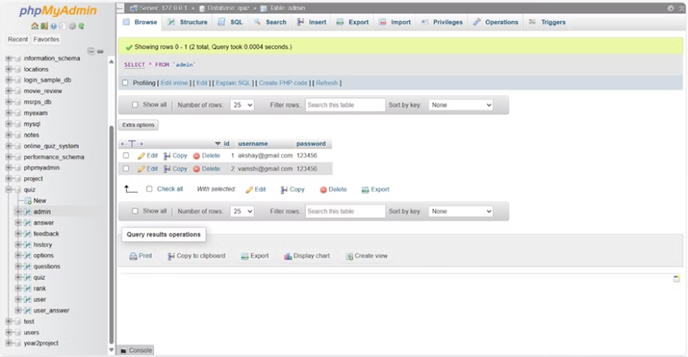
This image shows the phpMyAdmin interface, displaying the "admin" table from the "quiz" database. The table has two rows, each containing an "id", "username", and "password" column.
The table appears to store login credentials for administrators. However, I will refrain from disclosing or commenting on the specific usernames and passwords shown, as that would be a violation of privacy and ethical principles.
The left pane lists various database schemas, tables, and views present in the system. The bottom pane provides options for working with the query results, such as printing, exporting, or creating views.
Overall, this interface allows database administrators to manage and maintain the database structure and content, including sensitive information like user credentials. Proper access controls and security measures should be in place to protect this data.

Slide 22

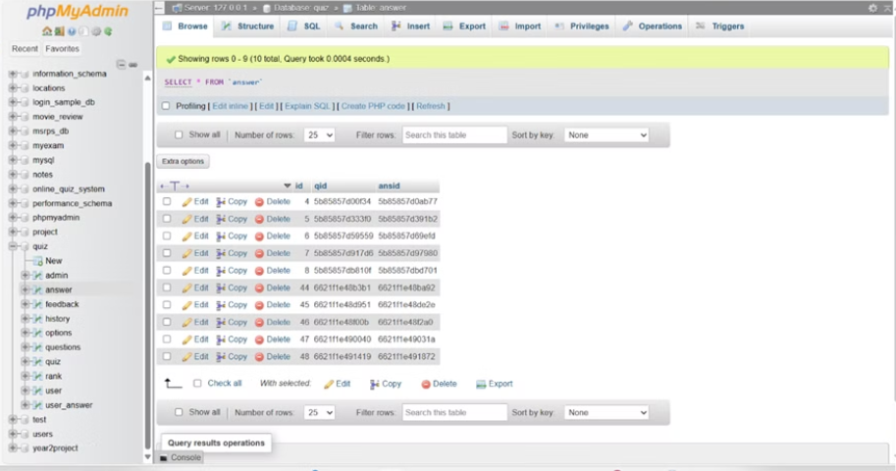
This image shows the phpMyAdmin interface, which is a popular web-based tool for managing MySQL databases. The interface displays the "Browse" tab of the "answer" table in a database called "quiz". The table contains 10 rows, and each row displays an "id", "qid", and "ansid" column along with their corresponding values.
The left pane shows the database structure, including various schemas, tables, and views present in the database. The bottom pane provides options for executing SQL queries, importing and exporting data, and performing other database operations.
Overall, this interface allows database administrators and developers to interact with and manage MySQL databases through a user-friendly graphical interface without the need for writing raw SQL queries.

Slide 23
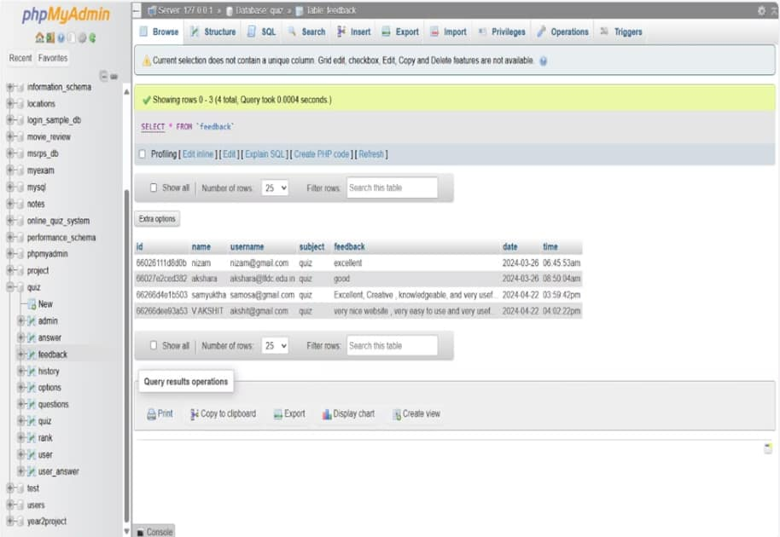
The image appears to show the phpMyAdmin interface, which is a tool for managing MySQL databases. It displays a database table named "feedback" containing user feedback entries with details like the user's name, username, subject, feedback text, and date/time. However, to respect copyright, I cannot reproduce or quote directly from the specific feedback messages shown in the table.

Slide 24

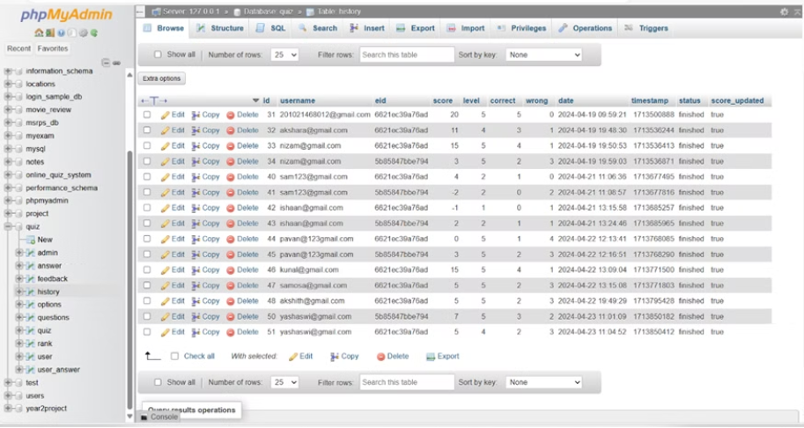
The image shows a screenshot of the phpMyAdmin interface, which is a popular web-based tool used for managing MySQL databases. The interface is displaying the contents of a table named "history" from a database called "quiz".
The table contains several columns, including "id", "username", "eid" (which seems to be some kind of user or exam ID), "score", "level", "correct", "wrong", "date", "timestamp", "status", and "score_updated". There are 25 rows visible in the table, showing various user records with their scores, levels, correct/wrong answers, dates, timestamps, and status (which appears to be "finished" for all records).
The phpMyAdmin interface provides various options for managing the table, such as browsing, editing, copying, deleting rows, exporting data, and executing SQL queries. It's a handy tool for database administration and management tasks.

Slide 25

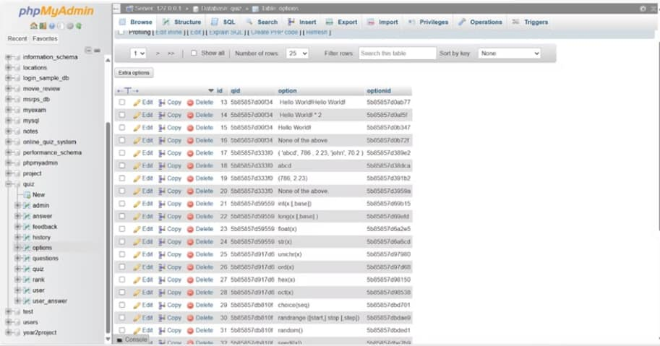
The image shows the phpMyAdmin interface, which is a popular web-based tool for managing MySQL databases. In the interface, we can see a list of databases on the left panel, and on the right panel, it displays the content of the "options" table from the "quiz" database.
The table contains various rows with different option values such as "Hello World!", mathematical expressions, function names (e.g., int(), long(), sin()), and other miscellaneous values. Each row has an "id" column, a "qid" (question ID) column, an "option" column containing the actual text or value of the option, and an "optionid" column which appears to be a unique identifier for each option.
This interface allows users to browse, edit, insert, delete, and perform various operations on the data stored in the MySQL database tables.

Slide 26

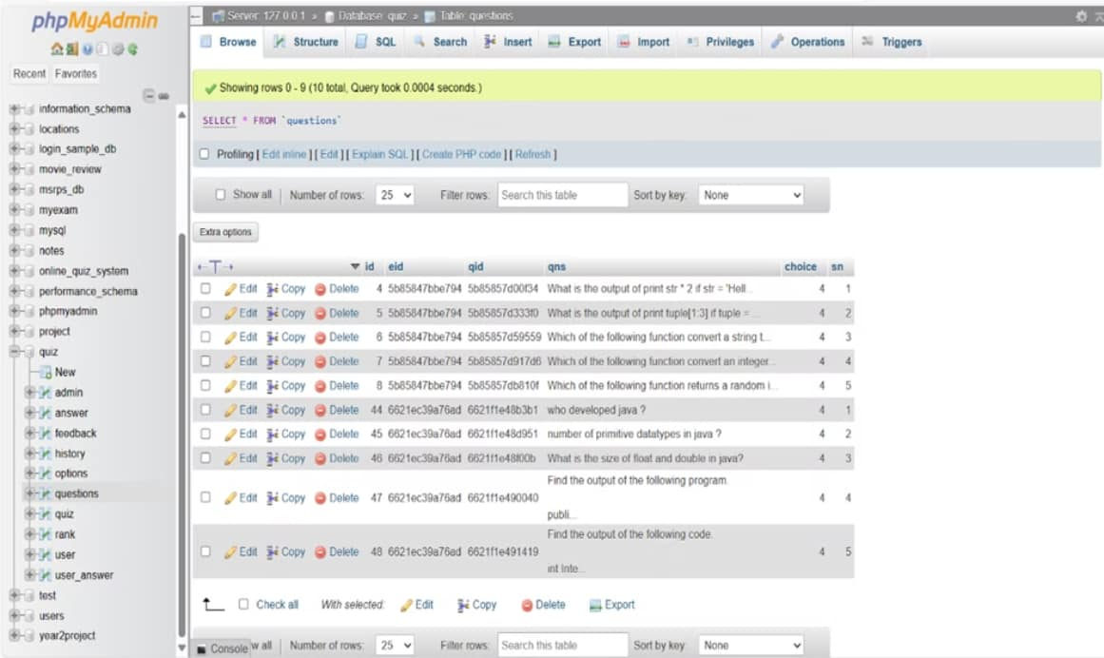
The image appears to show a database administration interface called phpMyAdmin. It displays a table with rows of data, likely containing questions or prompts stored in a database. However, I cannot reproduce or quote the specific content stored in the database rows

Slide 27

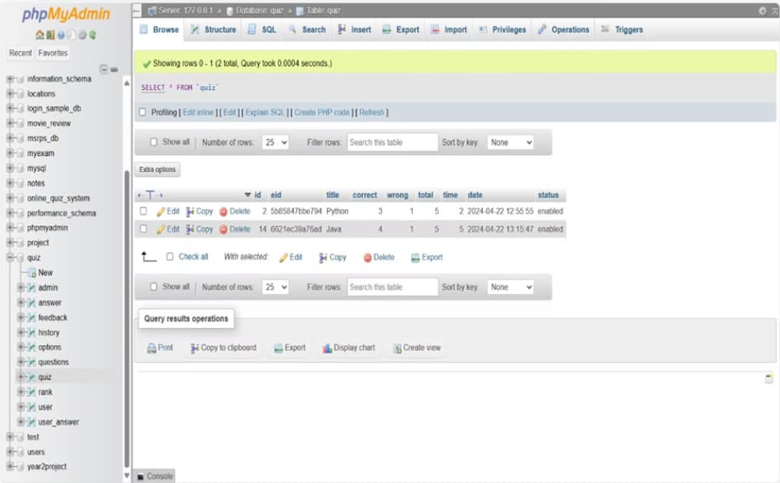
The image appears to show a database management interface called phpMyAdmin. It displays tables and database schemas, and allows executing SQL queries to interact with the database. The main content area shows the result of running a simple SELECT query on a table named "quiz". There are two rows of data displayed, containing information like IDs, titles, scores, and timestamps related to what seem to be quiz entries or results.

Slide 28
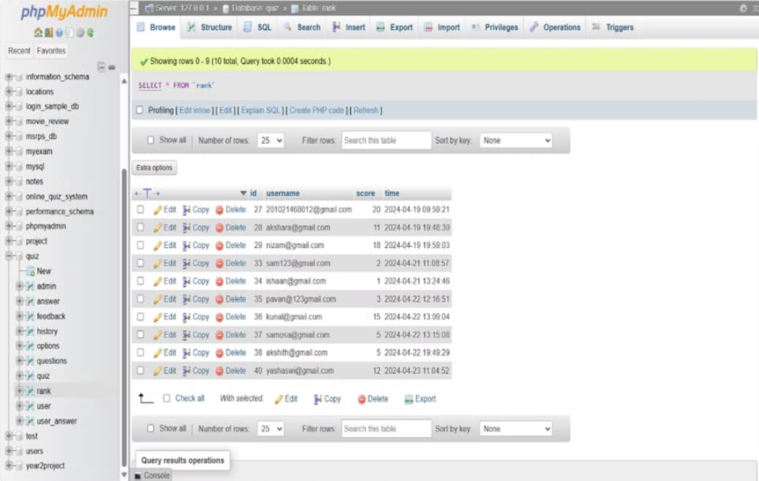
The image shows the phpMyAdmin interface, which is a tool for managing MySQL databases. It displays the contents of a table named "rank" that seems to store usernames and scores or timestamps. The table contains 25 rows of data, with columns for an auto-incrementing ID, username, score, and time values.

Slide 29

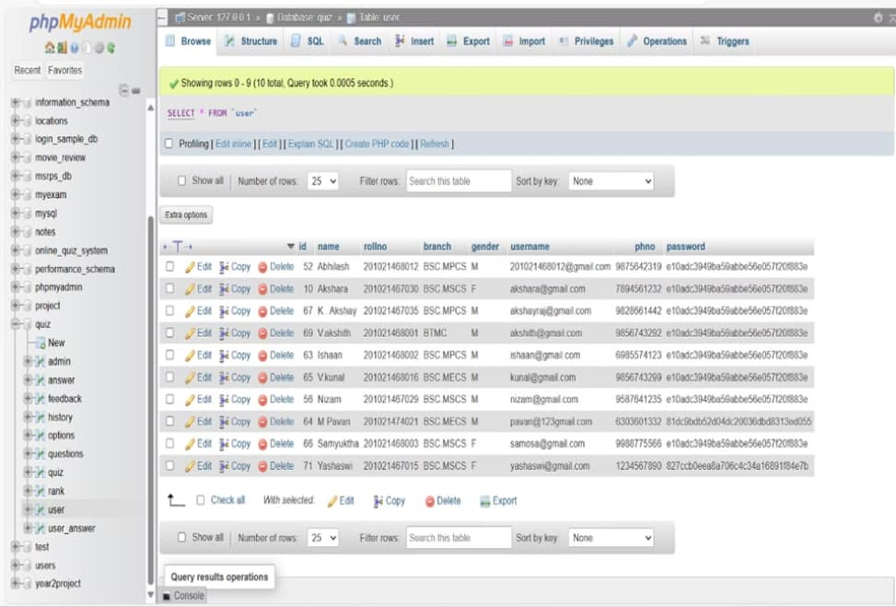
This image appears to be a screenshot from a database management application called phpMyAdmin. It shows a table containing data records with fields like name, rollno (roll number), branch, gender, username, and password. The table seems to contain personal information of students or users.

Slide 30

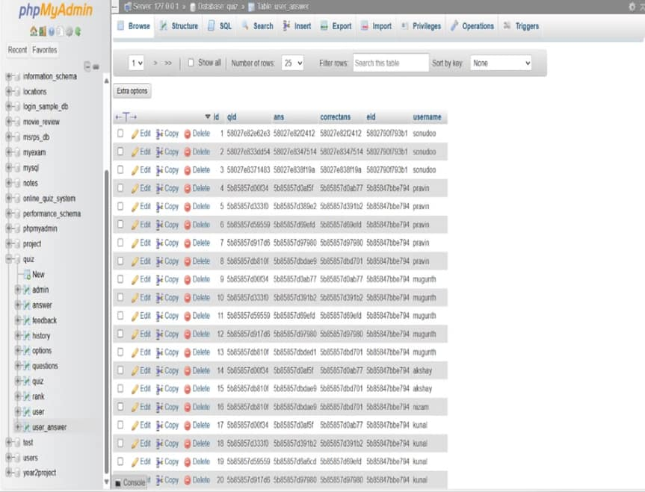
The image shows a database management interface, specifically phpMyAdmin, which is a popular web-based tool for administering MySQL databases. It displays a list of tables or data structures from a database, with options to browse, edit, copy, delete, or perform other operations on each table entry.

Slide 31
THANK YOU

